Slide 1
Norwalk Transportation Project
Prototype Slide Deck

Slide 2




Design Challenge
Our design challenge is to provide guidance to the city of Norwalk to make it easier for residents and visitors to wayfind using the city’s public transit infrastructure.

Slide 3
Prototype Portfolio
User Journey Map & Simulator
Wayfinding App & App Patches
Physical Signage & Kiosks

Slide 4
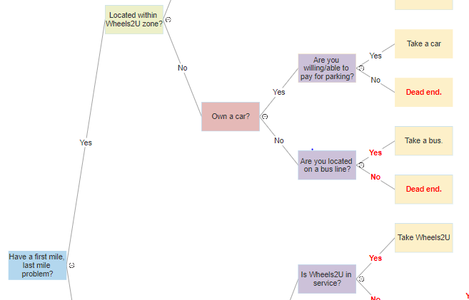
User Journey Map Simulator
Uses user research to map the experiences of different types of public transit users
Each path represents a different possible user experience
Can be refined and updated as new information is obtained
Helps planners identify obstacles and opportunities across the broader public transit system
Informs future transit-related policy and development

Slide 5
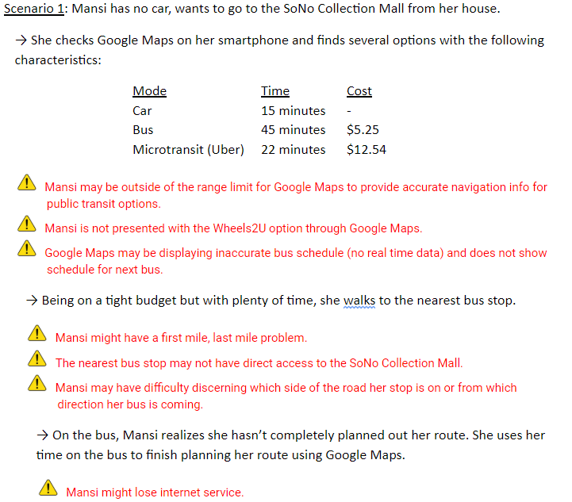
Example Use Case: No car scenario

Slide 6
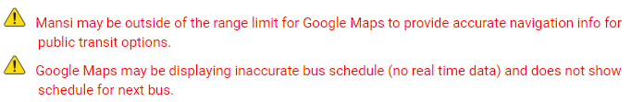
Wayfinding App & App Patches
Insights gleaned from User Journey Map Simulator become features in new local transit app
Other insights become supplements to existing Navigation apps, like Google Maps

Slide 7
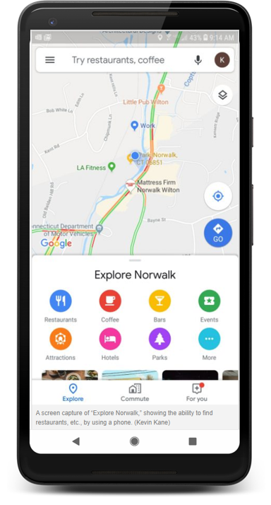
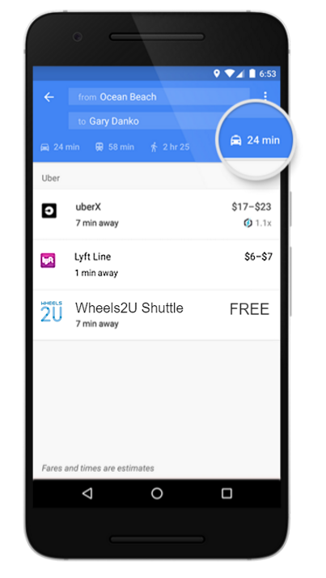
Norwalk Transit Patch for Google Maps

Slide 8

Physical Signage & Kiosks
Other insights become physical signage, directories, or interactive kiosks

Slide 9
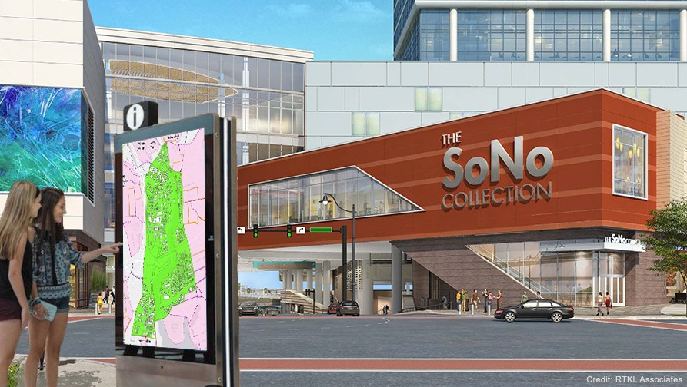
Physical Signage and Kiosks

